Slide 1
PROPERTIES OF MATERIALS

Slide 2
PROPERTIES OF MATERIALS
The data obtained in the result of materials testing can be used in specifying the suitability of materials for various applications—e.g., building or aircraft construction, machinery, or packaging. A full- or small-scale model of a proposed machine or structure may be tested. Alternatively, it’s possible to construct mathematical model that utilize known material characteristics and behaviour to predict capabilities of the structure.
Generally it’s possible to determine two major categories: physical and mechanical.

Slide 3
PROPERTIES OF MATERIALS
Standard test methods have been established by such national and international bodies as the International Organization for Standardization (ISO), with headquarters in Geneva, and theAmerican Society for Testing and Materials (ASTM), Philadelphia.

Slide 4
PHYSICAL PROPERTIES OF MATERIALS
Melting point | the temperature at which a metal melts. The metals of lower melting points are generally the soft metals and those of high melting the hard metals
Boiling point | the temperature at which the metal boils under normal atmospheric pressure
Heat conductivity | the heat conducting ability of a unit length or thickness of a substance per unit of cross-sectional area
Electrical conductivity | the electrical conducting power of a unit length per unit of cross-sectional area

Slide 5
PHYSICAL PROPERTIES OF MATERIALS
Magnetism | the magnetic force exerted by a unit volume of a substance under standard ma­gnetizing force
Porosity | the quality of containing pores is lack of denseness
Density | weight per unit of volume
Colour | Most of the metals are silvery white or grey in colour and have metallic lustre

Slide 6
Match the definitions to the key words of the unit:
1. porosity | A. the temperature at which a metal melts
2. composition | B. the electrical conducting power of a unit of cross sectional area
3. melting point | C. the quality of containing pores is lack of denseness
4. boiling point | D. the temperature at which the metal boils under normal atmospheric pressure
5. electrical conductivity | E. the manner of arrangement of metal atoms as to geometric form in solid crystals

Slide 7
MECHANICAL PROPERTIES OF MATERIALS
Strength | the property of resistance to external loads or stresses without incurring stru­ctural damage
Stress | the force within a body which resists deformation due to an externally applied load
Strain | distortion or deformation
Elasti­city | the property of regaining the original dimen­sions upon removal of the external load
Yield point | a point on the stress - strain curve at which the stress levels off or actually decreases while strain continues. The term is strictly applicable only to mild steels
Ultimate strength | the greatest load that the specimen has supported divided by the original cross-sectional area

Slide 8
MECHANICAL PROPERTIES OF MATERIALS
Ductility | the capacity of a metal to be per­manently deformed in tension without breaking
Toughness | the property of absorbing considerable energy before fracture. The tough­ness of a metal is indicated by the amount of slip which may occur within the crystals without resulting in rupture of the metal
Malleability | the property of a metal which permits permanent deformation by compression without rup­ture
Brittleness | the property of breaking without warning, i.e., without visible permanent deformation
Fatigue failure | failure of metals and alloys under repeated or alternating stresses, too small to produce even a permanent deformation when applied statically
Failure by corrosion fatigue | a fati­gue failure in which corrosion has lowered the endurance limit by the formation of pits that act as centers for the development of fatigue cracks
Hardness | a combination of a number of physical and mechanical properties

Slide 9
Match the definitions to the key words of the unit:
1. brittleness | A. the property of regaining the original dimen­sions upon removal of the external load
2. malleability | B. the property of breaking without warning
3. yield point | C. a combination of a number of physical and mechanical properties
4. elasti­city | D. a point on the stress - strain curve at which the stress levels off or actually decreases while strain continues
5. hardness | E. the property of a metal which permits permanent deformation by compression without rup­ture

Slide 10
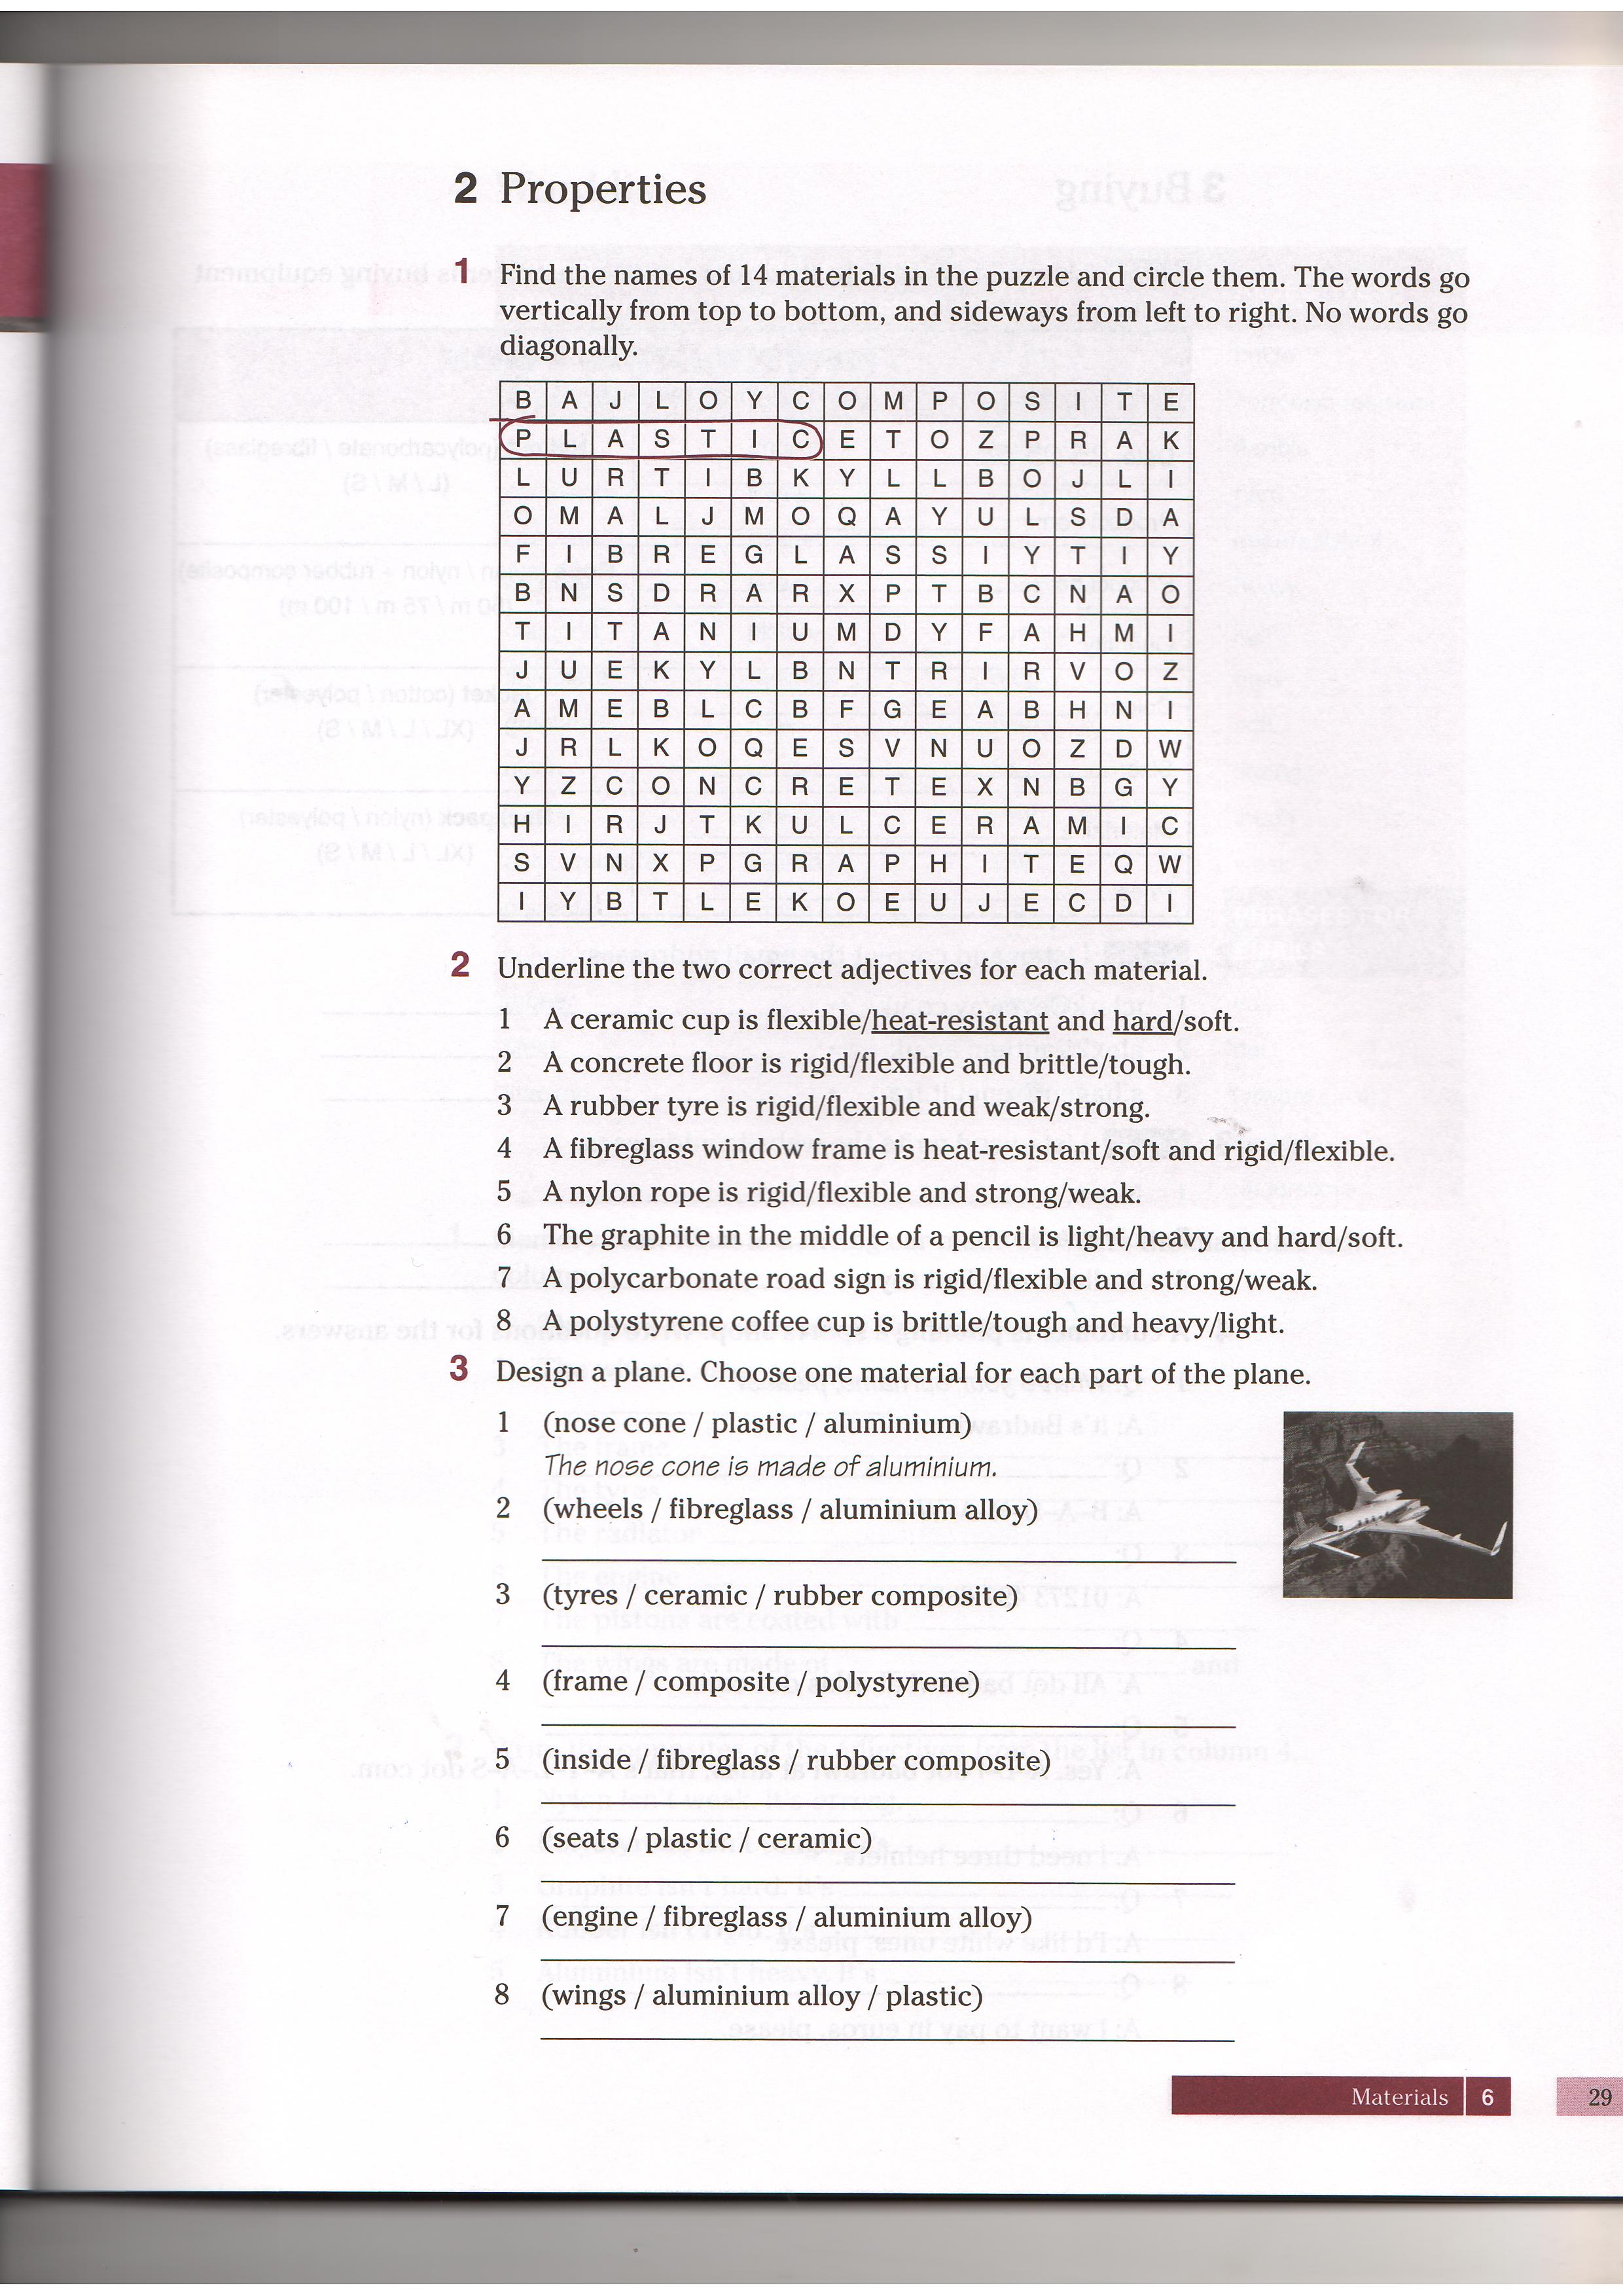

Slide 11


